Slide 1

Transformer Network
Learning Objectives:
Create positional encodings to capture sequential relationships in data
Calculate scaled dot-product self-attention with word embeddings
Implement masked multi-head attention
Build and train a Transformer model
Fine-tune a pre-trained transformer model for Named Entity Recognition
Fine-tune a pre-trained transformer model for Question Answering
Implement a QA model in TensorFlow and PyTorch
Fine-tune a pre-trained transformer model to a custom dataset
Perform extractive Question Answering

Slide 2
Transformer Network
1 Transformers Intuition
2 Self-Attention
3 Multi-Head Attention
4 Transformers

Slide 3
Transformer Network
Transformers
Intuition

Slide 4
Transformers Motivation
The development of Transformers was motivated by the limitations of traditional sequence-to-sequence models in capturing long-term dependencies in input sequences due to the vanishing gradient problem.
Transformers use self-attention mechanisms to attend to different parts of the input sequence at different time steps, enabling them to capture long-term dependencies more effectively and leading to improved performance in natural language processing tasks.
Notes:
The development of Transformers was to address the limitations of traditional sequence-to-sequence models in capturing long-term dependencies in input sequences. Traditional models such as RNNs and LSTMs suffer from the vanishing gradient problem, which makes it difficult to capture dependencies that are far apart in the input sequence.
Transformers were designed to overcome this limitation and improve the performance of sequence-based models in various natural language processing tasks, such as machine translation and language modeling. Transformers achieve this by using self-attention mechanisms that allow them to attend to different parts of the input sequence at different time steps, without requiring a fixed-length context window as in traditional models. This enables them to capture long-term dependencies in the input sequence more effectively, leading to improved performance in various natural language processing tasks.

Slide 5
Transformers Motivation
The transformer architecture is very popular in the field of natural language processing (NLP).
It is a complex architecture, but it allows for parallel processing of entire sequences, rather than ingesting input one word or token at a time. This is in contrast to RNNs, GRUs, and LSTMs, which are all sequential models that process input one unit at a time. As the complexity of sequence tasks increases, so does the complexity of the model.
The major innovation of the transformer architecture is the combination of attention-based representations and a CNN-style of processing.

Slide 6
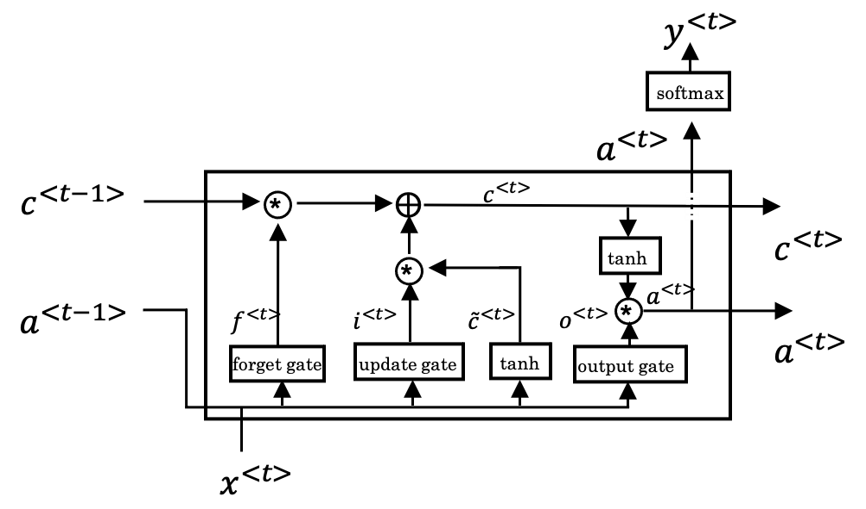
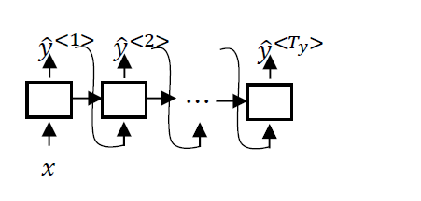
Transformers Motivation
Increased complexity, sequential
RNN
GRU
LSTM

Slide 7
Transformers Intuition
The attention network is a way of computing rich and useful representations of words in parallel using self-attention and multi-headed attention.
The transformer architecture overcomes the limitations of traditional sequence-to-sequence models in capturing long-term dependencies.
The next section will cover the self-attention and multi-headed attention processes in detail and put all the pieces together to give a complete understanding of how the transformer works.
Notes:
The attention network allows for the computation of rich and useful representations of words in parallel. The two key ideas in the attention network are self-attention and multi-headed attention. Self-attention is a way of computing representations for all words in a sentence in parallel, while multi-headed attention is a loop over the self-attention process to obtain multiple versions of the representations. These rich representations can be used for machine translation and other NLP tasks.
The transformer architecture was introduced in a paper by Vaswani et al., and one of the inventors, Lucas Kaiser, is also a co-instructor of the NLP specialization with deep learning.ai. In the next few videos, the self-attention and multi-headed attention processes will be discussed in detail, and the final video will put all of the pieces of the transformer architecture together to give a complete understanding of how it works.

Slide 8
Transformers Intuition
Attention + CNN
Self-Attention
Multi-Head Attention

Slide 9
Sequence to
sequence models
Self-Attention

Slide 10
Self-Attention Intuition
The attention values are then computed using the dot product of the query and key, and scaled by the square root of the dimension of the key.
The resulting attention weights are used to compute a weighted sum of the values, which gives the attention-based representation for each word.
The self-attention mechanism allows for the parallel computation of these representations, making it more efficient than traditional sequence-to-sequence models.
Notes:
The transformer network is a deep learning architecture that has revolutionized natural language processing (NLP) by allowing for parallel computation of input sequences.
The self-attention mechanism is a key component of the transformer network that allows for the computation of attention-based representations for each word in a sentence. This is done by associating each word with three values called query, key, and value, which are learned matrices that allow for the computation of attention values. The query allows for asking a question about the word, such as "what's happening in Africa?" The key looks at all the other words and helps to figure out which word gives the most relevant answer to the question.

Slide 11
Self-Attention Intuition
𝐴(𝑞, 𝐾, 𝑉)= attention-based vector representation of a word
RNN Attention
Transformers Attention
_{𝛼}<𝑡,𝑡′> ₌
exp(𝑒^{<𝑡,𝑡′>})
𝐴(𝑞, 𝐾, 𝑉)= ∑_{𝑖}
exp(𝑒^{<𝑞∙𝑘<𝑖>>})
_{𝑣}<𝑖>
∑𝑇_{𝑥}
∑_{𝑗} exp(𝑒^{<𝑞∙𝑘}
<𝑗>
>₎
exp(𝑒^{<𝑡,𝑡′>})
𝑡′=1
_{𝑥}<3>
l’Afrique
_{𝑥}^{<1>} _{𝑥}^{<2>} _{𝑥}^{<4>} _{𝑥}<5>
Jane visite en septembre

Slide 12
Self-Attention
The value of each word in a sentence can be plugged into the attention-based representation for the sentence, allowing for a richer and more nuanced representation of words than fixed word embeddings.
This self-attention mechanism can be used to create attention-based representations for all the words in a sentence, which can be combined in a compressed or vectorized representation using the scaled dot-product attention mechanism.
The multi-headed attention mechanism adds a loop over the self-attention mechanism, creating multiple attention-based representations for each word and allowing for even more complex and nuanced representations of input sequences.
Notes:
The value allows the representation to be plugged in, indicating how the word should be represented within the attention-based representation for the sentence. This leads to a richer and more nuanced representation of words than fixed word embeddings.
The self-attention mechanism can be used to create attention-based representations for all the words in a sentence, which can be combined in a compressed or vectorized representation using the scaled dot-product attention mechanism.
The multi-headed attention mechanism puts a loop over the self-attention mechanism, creating multiple attention-based representations for each word, allowing for even more complex and nuanced representations of input sequences.

Slide 13
Self-Attention
exp(𝑒^{<𝑞∙𝑘<𝑖>>})
_{𝑣}<𝑖>
𝐴(𝑞, 𝐾, 𝑉)= ∑_{𝑖}
∑_{𝑗} exp(𝑒^{<𝑞∙𝑘}
<𝑗>
>₎
𝑸𝑲^{𝑻}
𝑨𝒕𝒕𝒆𝒏𝒕𝒊𝒐𝒏 𝑸, 𝑲, 𝑽
= 𝒔𝒐𝒇𝒕𝒎𝒂𝒙
𝑽
𝒅_{𝒌}
_{𝐴}<1>
_{𝐴}<2>
_{𝐴}<3>
_{𝐴}<4>
_{𝐴}<5>
+
Query (𝑄)
Key (𝐾)
Value (𝑉)
_{𝑣}<1>
x
_{𝑣}<2>
x
_{𝑣}<3>
x
x
_{𝑣}<4>
x
_{𝑣}<5>
_{𝑞}<1> | _{𝑘}<1> | _{𝑣}<1>
_{𝑞}<2> | _{𝑘}<2> | _{𝑣}<2>
_{𝑞}<3> | _{𝑘}<3> | _{𝑣}<3>
_{𝑞}<4> | _{𝑘}<4> | _{𝑣}<4>
_{𝑞}<5> | _{𝑘}<5> | _{𝑣}<5>
_{𝑞}<3> _{∙ 𝑘}<1>
_{𝑞}<3> _{∙ 𝑘}<2>
_{𝑞}<3>_{, 𝑘}<3>
_{𝑞}<3> _{∙ 𝑘}<4>
_{𝑞}<3> _{∙ 𝑘}<5>
_{𝑞}<1>_{, 𝑘}<1>_{, 𝑣}<1>
_{𝑞}<2>_{, 𝑘}<2>_{, 𝑣}<2>
_{𝑞}<3>_{, 𝑘}<3>_{, 𝑣}<3>
_{𝑞}<4>_{, 𝑘}<4>_{, 𝑣}<4>
_{𝑞}<5>_{, 𝑘}<5>_{, 𝑣}<5>
_{𝑥}^{<1>} _{𝑥}^{<2>} _{𝑥}^{<3>} _{𝑥}<4> _{𝑥}<5>
Jane visite l’Afrique en septembre

Slide 14
Sequence to sequence models
Multi-Head
Attention

Slide 15
Multi-Head Attention
In multi-head attention mechanism, the input is multiplied with weight matrices to obtain query, key, and value vectors.
Self attention is computed multiple times, each time using a different set of weight matrices referred to as "heads". Each head represents a different feature and asks a different question about the input sequence. The output of each head is concatenated and multiplied by a final weight matrix to produce the final output. This computation can be done in parallel, making it computationally efficient and suitable for use in large-scale deep learning models such as the transformer network.
Notes:
In the multi head attention mechanism, the input consists of query, key, and value vectors, which are obtained by multiplying the original input sequence with weight matrices. The multi head attention then computes self attention multiple times, where each time a different set of weight matrices are used to generate new query, key, and value vectors. These sets of weight matrices are referred to as "heads," and the number of heads is typically denoted by the variable H.
Each head represents a different feature, which is learned by asking a different question about the input sequence. For example, one head might ask "what's happening," while another head might ask "when is something happening," and a third head might ask "who has something to do with Africa." Each head's output is then concatenated with the other heads' outputs and multiplied by a final weight matrix to produce the final output of the multi head attention mechanism.
While conceptually, these different computations can be thought of as being done sequentially in a loop, in practice, they can be computed in parallel because the output of each head does not depend on the output of any other head. This makes the multi head attention mechanism computationally efficient and allows it to be used in large scale deep learning models like the transformer network.
In the next section, the multi head attention mechanism will be incorporated into the transformer network, and a simplified icon will be used to denote the multi head attention computation.

Slide 16
Multi-Head Attention
_{𝑀𝑢𝑙𝑡𝑖𝐻𝑒𝑎𝑑 𝑄, 𝐾, 𝑉} = 𝑐𝑜𝑛𝑐𝑎𝑡 ℎ𝑒𝑎𝑑₁ℎ𝑒𝑎𝑑₂ … ℎ𝑒𝑎𝑑_{𝑛} 𝑊_{𝑜}
^{𝑄} 𝐾 𝑉
_{𝑸𝑲}^{𝑻} ℎ𝑒𝑎𝑑_{𝑖} = 𝐴𝑡𝑡𝑒𝑛𝑡𝑖𝑜𝑛 (𝑊_{𝑖} 𝑄, 𝑊_{𝑖} 𝐾, 𝑊_{𝑖} 𝑉)
𝑨𝒕𝒕𝒆𝒏𝒕𝒊𝒐𝒏 𝑸, 𝑲, 𝑽 = 𝒔𝒐𝒇𝒕𝒎𝒂𝒙 𝑽
𝒅_{𝒌}
^{𝑸𝑸 𝑲}𝑲 ^{𝑽}𝑽
^{𝑨𝒕𝒕𝒆𝒏𝒕𝒊}𝑨𝒕𝒕𝒆𝒏𝒕𝒊^{𝒐}𝒐𝒏^{𝒏(}(^{𝑾}𝑾_{𝟏𝒊} ^{𝑸}𝑸,, ^{𝑾}𝑾_{𝟏𝒊} ^{𝑲}𝑲,, ^{𝑾}𝑾_{𝟏𝒊} ^{𝑽}𝑽⁾)
^{Q} K V
W₃ , W₃ , W₃ , Who?
𝑄𝑄 <<11>> 𝐾𝐾 <<11>> 𝑉𝑉 <<11>> 𝑄𝑄 <<22>> ^{𝐾𝐾} <<22>> ^{𝑉𝑉} <<22>> ^{𝑄𝑄} <<33>> ^{𝐾𝐾} <<33>> ^{𝑉𝑉} <<33>> ^{𝑄𝑄} <4> ^{𝐾𝐾 <}<⁴4>> ^{𝑉𝑉 <}<⁴4>> 𝑄𝑄 <<55>> 𝐾𝐾 <<55>> 𝑉𝑉 <<55>>
^{𝑊𝑊}_{1𝑖} ^{𝑞𝑞 ,, 𝑊𝑊}_{1𝑖} ^{𝑘𝑘 ,,𝑊𝑊}_{1𝑖} ^{𝑣𝑣} 𝑊𝑊_{1𝑖} 𝑞𝑞 ,, 𝑊𝑊_{1𝑖} 𝑘𝑘 ,,𝑊𝑊_{1𝑖} 𝑣𝑣 𝑊𝑊_{1𝑖} 𝑞𝑞 ,, 𝑊𝑊_{1𝑖} 𝑘𝑘 ,,𝑊𝑊_{1𝑖} 𝑣𝑣 ^{𝑊}𝑊_{1𝑖} ^{𝑞}𝑞^{<4>,}, ^{𝑊}𝑊_{1𝑖} ^{𝑘}𝑘 ,,^{𝑊}𝑊_{1𝑖} ^{𝑣}𝑣 ^{𝑊𝑊}_{1𝑖} ^{𝑞𝑞 ,, 𝑊𝑊}_{1𝑖} ^{𝑘𝑘 ,,𝑊𝑊 𝑣𝑣}
^{Q} K V
W₂ , W₂ , W₂ , When?
^{Q} K V
W₁ , W₁ , W₁ , Did what?
_{𝑞}^{<1>}_{, 𝑘}^{<1>}_{, 𝑣}^{<1>} _{𝑞}<2>_{, 𝑘}<2>_{, 𝑣}<2> _{𝑞}^{<3>}_{, 𝑘}^{<3>}_{, 𝑣}^{<3>} _{𝑞}<4>_{, 𝑘}<4>_{, 𝑣}<4> _{𝑞}<5>_{, 𝑘}<5>_{, 𝑣}<5>
_{𝑥}^{<3>} W^{Q}, W^{K} , W^{V}
l’Afrique
Multi-Head Attention
_{𝑥}^{<1>} _{𝑥}^{<2>} _{𝑥}^{<4>} _{𝑥}<5>
Jane visite en septembre

Slide 17
Sequence to
sequence models
Transformers

Slide 18
Transformer Details
The Transformer network is an architecture that uses self-attention and multi-headed attention mechanisms to perform sequence-to-sequence tasks, such as machine translation.
The network has an encoder and decoder block, each with multiple layers.
The encoder produces a contextualized embedding for each word using multi-headed attention and feed-forward neural networks.
The decoder generates the translated output using a similar multi-headed attention mechanism, generating the output one word at a time.
Additional features such as positional encoding, residual connections, and masking during training are used to improve performance. Variations of the model, such as BERT and BERT distill, have also been proposed.
Notes:
The Transformer network is an architecture that uses self-attention and multi-headed attention mechanisms to perform sequence-to-sequence tasks, such as machine translation.
The network consists of an encoder and a decoder block, each of which contains multiple layers.
The encoder block receives input text and produces a contextualized embedding for each word using multi-headed attention and feed-forward neural networks.
The decoder block takes in the output of the encoder and generates the translated output by attending to the input text and using a similar multi-headed attention mechanism. The decoder generates the output one word at a time, with each word being fed back into the decoder block to inform the generation of the next word.
To improve the performance of the Transformer network, several additional features are used. Positional encoding is used to encode the position of each word in the input sequence, which is important for tasks such as translation. Residual connections and layer normalization are used to improve the flow of information through the network and to speed up learning. Finally, a linear and softmax layer are used in the decoder to predict the next word in the sequence.
During training, the Transformer network uses a masking technique that blocks out the last part of the output sequence to simulate the generation of the output one word at a time. This allows the network to learn to generate the correct output in a sequential manner. Since the original Transformer paper, several variations of the model have been proposed, such as BERT and BERT distill.

Slide 19
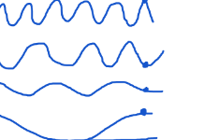




Transformer Details
Encoder
^{<SOS>} Jane visits Africa in September ^{<EOS>}
Softmax Linear
Decoder
Add & Norm
Add & Norm
Feed Forward Neural Network
Feed Forward Neural Network
i = 1
i = 2
i = 3
i = 4
POS
Add & Norm
Add & Norm
Multi-Head Attention
Multi-Head Attention
Add & Norm
Masked
Multi-Head
Multi-Head
Attention
+
Positional Encoding
Attention
_{… 𝑥}<𝑇_{𝑥}−1> _{𝑥}<𝑇_{𝑥}
𝑃𝐸
𝑝𝑜𝑠
= 𝑠𝑖𝑛( )
<SOS> 𝑥^{<1>} 𝑥^{<2> >} <EOS>
(𝑝𝑜𝑠,2𝑖)
2𝑖
1000 ^{𝑑}
Jane visite l’Afrique en septembre
+
_{𝑦}<2> _{… 𝑦}<𝑇_{𝑦}−1> _{𝑦}<𝑇_{𝑦}>
𝑝𝑜𝑠
2𝑖 ⁾
^{𝑃𝐸}(𝑝𝑜𝑠,2𝑖+1) ^{= 𝑐𝑜𝑠(}
<SOS> 𝑦^{<1>}
1000 ^{𝑑}
[Vaswani et al. 2017, Attention Is All You Need]

Slide 20
Summarization
Transformers, introduced in "Attention is All You Need," use self-attention for sequential data.
Self-attention allows dynamic weighing of words based on relationships. Multi-head attention enhances this by focusing on different parts simultaneously.
Transformers consist of encoder and decoder layers with self-attention and feed-forward networks. They excel in NLP, surpassing RNNs and CNNs due to parallelization and long-range dependency handling.
Notes:
Transformers Intuition:
Transformers are a class of neural networks introduced in the paper "Attention is All You Need" by Vaswani et al. They are designed to handle sequential data using a mechanism called self-attention, which allows the network to weigh the significance of different words in the input sequence dynamically.
Self-Attention:
Self-attention is a mechanism that enables each word in an input sequence to focus on different words, including itself, with varying degrees of attention. It calculates attention scores for each word in the sequence based on its relationship with other words, allowing the model to consider context effectively.
Multi-Head Attention:
Multi-head attention extends the basic self-attention mechanism by allowing the model to focus on different parts of the input sequence simultaneously. It computes multiple sets of attention weights, each called a "head," which are then linearly combined, enabling the model to capture diverse patterns and dependencies in the data.
Transformers:
Transformers are neural networks based on the self-attention mechanism. They consist of an encoder and a decoder, both built with multiple layers of self-attention and feed- forward neural networks. Transformers have revolutionized natural language processing tasks, outperforming traditional recurrent neural networks and convolutional neural networks in various applications. The architecture's parallelizability and ability to capture long-range dependencies make it highly effective for sequential data processing tasks.

